Slide 1
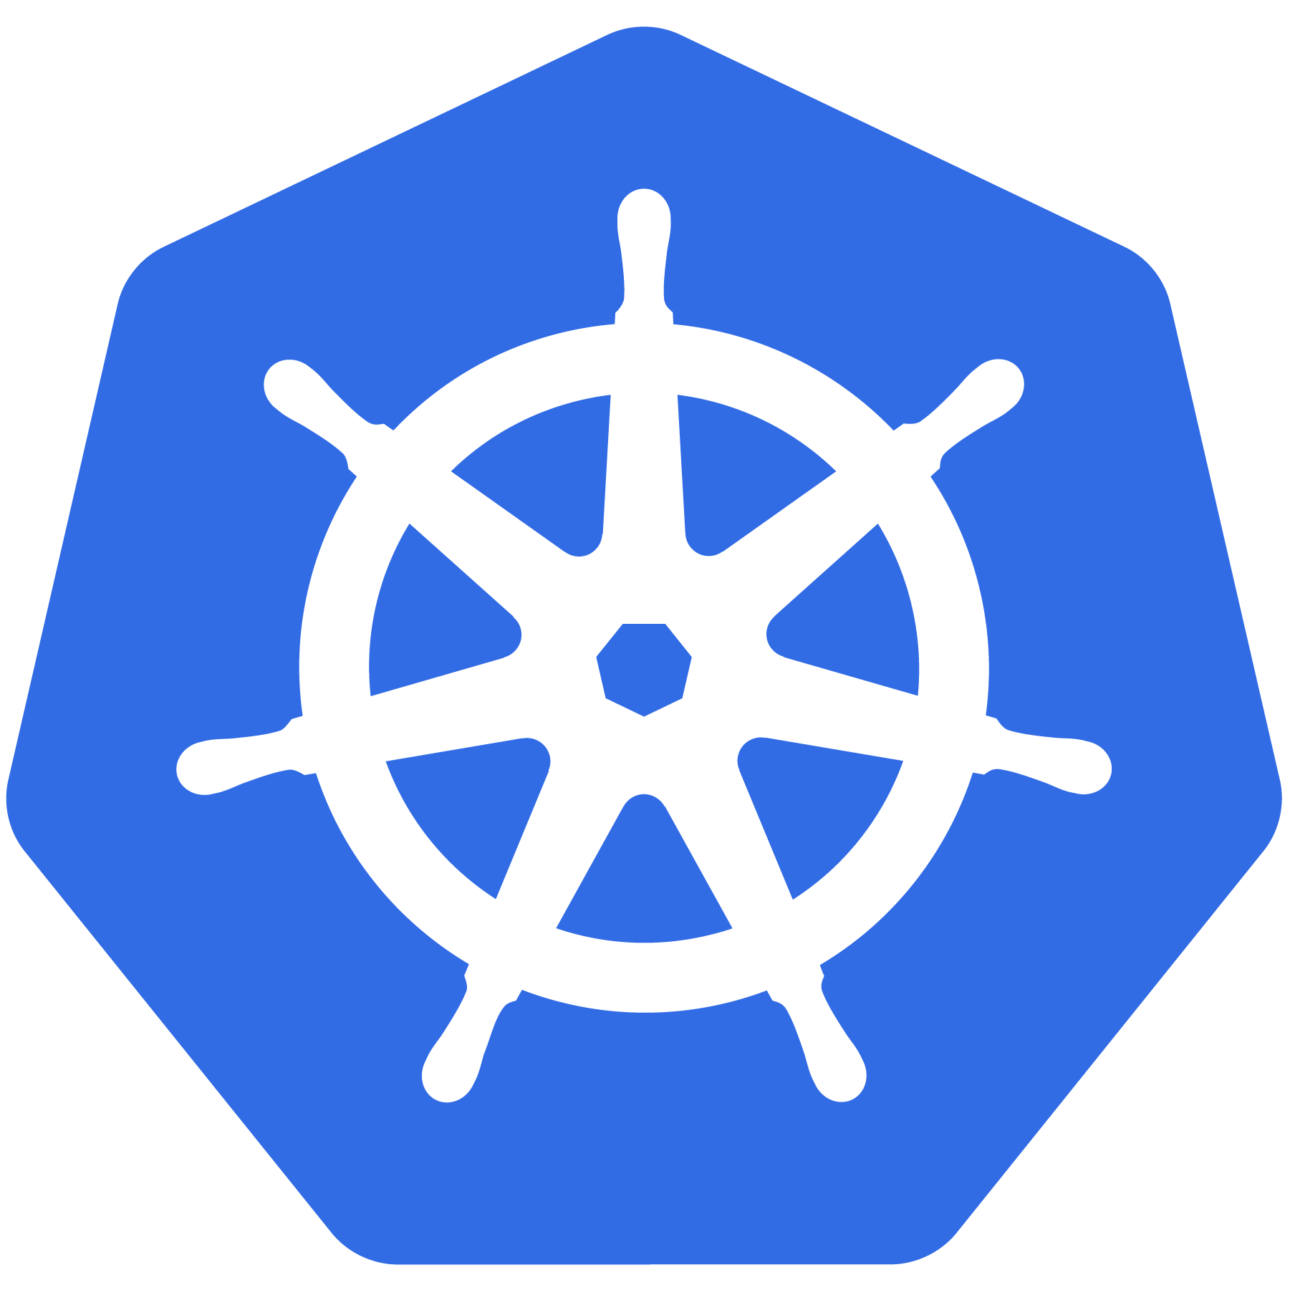
MasterClass
Kubernetes
An Introduction by : Mohd ASEEM AKRAM

Slide 2

What Does “Kubernetes” Mean?
Greek for “pilot” or
“Helmsman of a ship”
Pirates of the Caribbean – Jack sparrow
Notes:
The first question always asked
There is also the abbreviation of K8s -- K, eight letters, s

Slide 3
Kubernetes: A Must-Have Skill for DevOps Engineers Market Essential: Kubernetes is a cornerstone technology in the DevOps field. As a DevOps engineer, having expertise in Kubernetes is crucial and frequently highlighted in job descriptions. Job Market Insight: Every job search will show that Kubernetes skills are often a key requirement for DevOps roles, reflecting its importance in the industry. Pathways: lacking it might limit your scope to positions like Release Engineer or Platform Engineer. Mastering Kubernetes positions you as a complete DevOps professional.
Why learn Kubernetes?

Slide 4
Docker issue History?
Created a Docker container and after sometime I found my application is not accessible . We can recreate /restart or log check to fix the issue .
If my application is crash, Instead of create container in the cluster i.e. Kubernetes cluster
Kubernetes monitor the 24x7 my application container.
Decide 4gb Ram to my application . Liveness prob of our container with Readiness probe , health check and accessibility of our application , manages the Kubernetes the load of traffic to scale the container with copies of our application. Self heal.
Kubernetes is totally free that is Open sources . Manages the containers.
Notes:
There’s a phrase called Google-scale. This was developed out of a need to scale large container applications across Google-scale infrastructure
borg is the man behind the curtain managing everything in google
Kubernetes is loosely coupled, meaning that all the components have little knowledge of each other and function independently.
This makes them easy to replace and integrate with a wide variety of systems

Slide 5
Docker vs K8s?
Docker is a platform that enables developers to automate the deployment of applications inside lightweight, portable containers.
Docker Doesn’t solve Problem – single host ec2 - one Docker based – multiple container Auto Healing without user intervention Auto Scaling when load increase on app increase Docker simple platform – Firewall DNS API GATEWAYS – restrict IP – whitelist IP , during DDOS attacks
Kubernetes is a container orchestration platform designed to manage containerized applications at scale. Key Features: Container Orchestration Load Balancing Self-Healing
Scaling High Availability Complex Deployments

Slide 6
Whats is Kubernetes ?
Kubernetes: The Powerhouse of Container Orchestration
Open Source & Industry-Standard: Kubernetes is a leading open-source platform designed to automate the deployment, scaling, and management of containerized applications.
Effortless Management: It intelligently schedules, runs, and manages containers across various environments, including virtual machines, physical servers, and cloud infrastructure.
Seamless Integration: Fully supported by all major cloud providers, Kubernetes ensures smooth and scalable application deployment across AWS, Azure, Google Cloud, and more.
Notes:
There’s a phrase called Google-scale. This was developed out of a need to scale large container applications across Google-scale infrastructure
borg is the man behind the curtain managing everything in google
Kubernetes is loosely coupled, meaning that all the components have little knowledge of each other and function independently.
This makes them easy to replace and integrate with a wide variety of systems

Slide 7
Kubernetes History?
Google developed an internal system call Borg [later renamed as Omega]. It’s a Production-Grade Container Orchestration System.
Google spawns billions of containers per week with these systems.
Created by three Google employees initially during the summer of 2014; grew exponentially and became the first project to get donated to the CNCF.
Hit the first production-grade version v1.0.1 in July 2015. Has continually released a new minor version every three months since v1.2.0 in March 2016. Lately v1.31.0 was released in 13 August 2024.
Notes:
There’s a phrase called Google-scale. This was developed out of a need to scale large container applications across Google-scale infrastructure
borg is the man behind the curtain managing everything in google
Kubernetes is loosely coupled, meaning that all the components have little knowledge of each other and function independently.
This makes them easy to replace and integrate with a wide variety of systems

Slide 8
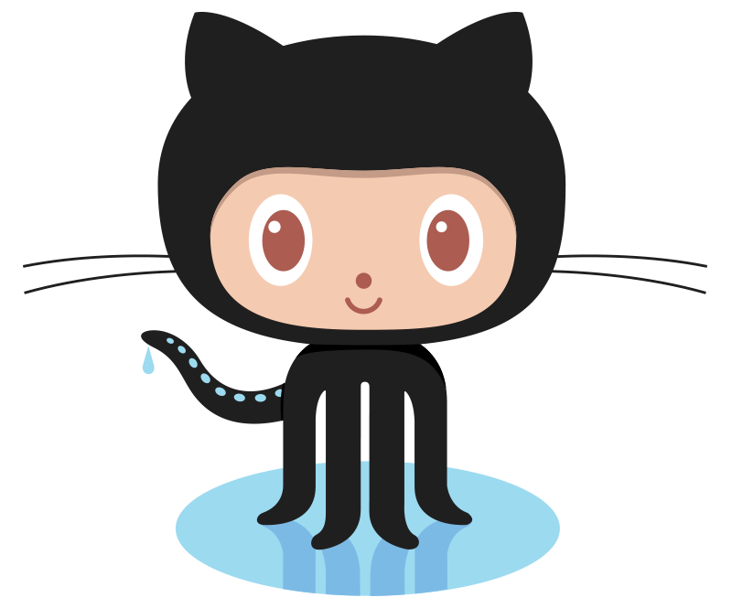
Project Stats
Very active Opensource project
Over 190k stars on Github
3680+ Contributors to K8s Core
GitHub - kubernetes/kubernetes: Production-Grade Container Scheduling and Management
Most discussed Repository by a large margin
50,000+ users in Slack Team
8/2024
Notes:
Very active project
42k starts on github
1800+ contributors to main core repo
most discussed repo on github
massive slack team with 50k+ users

Slide 9
Friends : Docker + K8s
How They Work Together ??
Docker for Containerization: Docker is used to build and package your application into containers. Pushed to Organization private repositories
Kubernetes for Orchestration: Kubernetes is used to deploy, manage, and scale those containers across a cluster of machines.
Notes:
There’s a phrase called Google-scale. This was developed out of a need to scale large container applications across Google-scale infrastructure
borg is the man behind the curtain managing everything in google
Kubernetes is loosely coupled, meaning that all the components have little knowledge of each other and function independently.
This makes them easy to replace and integrate with a wide variety of systems

Slide 10
Decouples Infrastructure and Scaling
All services within Kubernetes are natively Load Balanced.
Can scale up and down dynamically.
Used both to enable self-healing and seamless upgrading or rollback of applications.
Notes:
A lot of key components are batteries-included

Slide 11
Self Healing
Kubernetes will ALWAYS try and steer the cluster to its desired state.
Me: “I want 3 healthy instances of APP to always be running.”
Kubernetes: “Okay, I’ll ensure there are always 3 instances up and running.”
Kubernetes: “Oh look, one has died. I’m going to attempt to spin up a new one.”
Notes:
The instance will have a new IP and likely be on a different host, but Kubernetes gives the primitives for us to ‘not care’ about that.

Slide 12
A Couple
Key Concepts...
Notes:
There are a few small things we should mention
It’s kind of a chicken and egg problem. But we need to talk about these before the stuff that supports and extends it

Slide 13
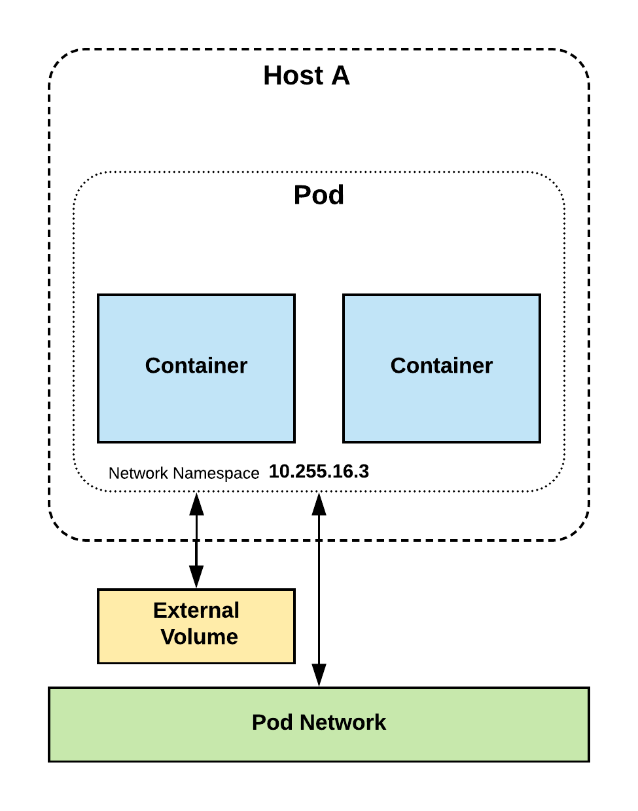
Pods
Atomic unit or smallest “unit of work”of Kubernetes.
Pods are one or MORE containers that share volumes and namespace.
They are also ephemeral!

Slide 14
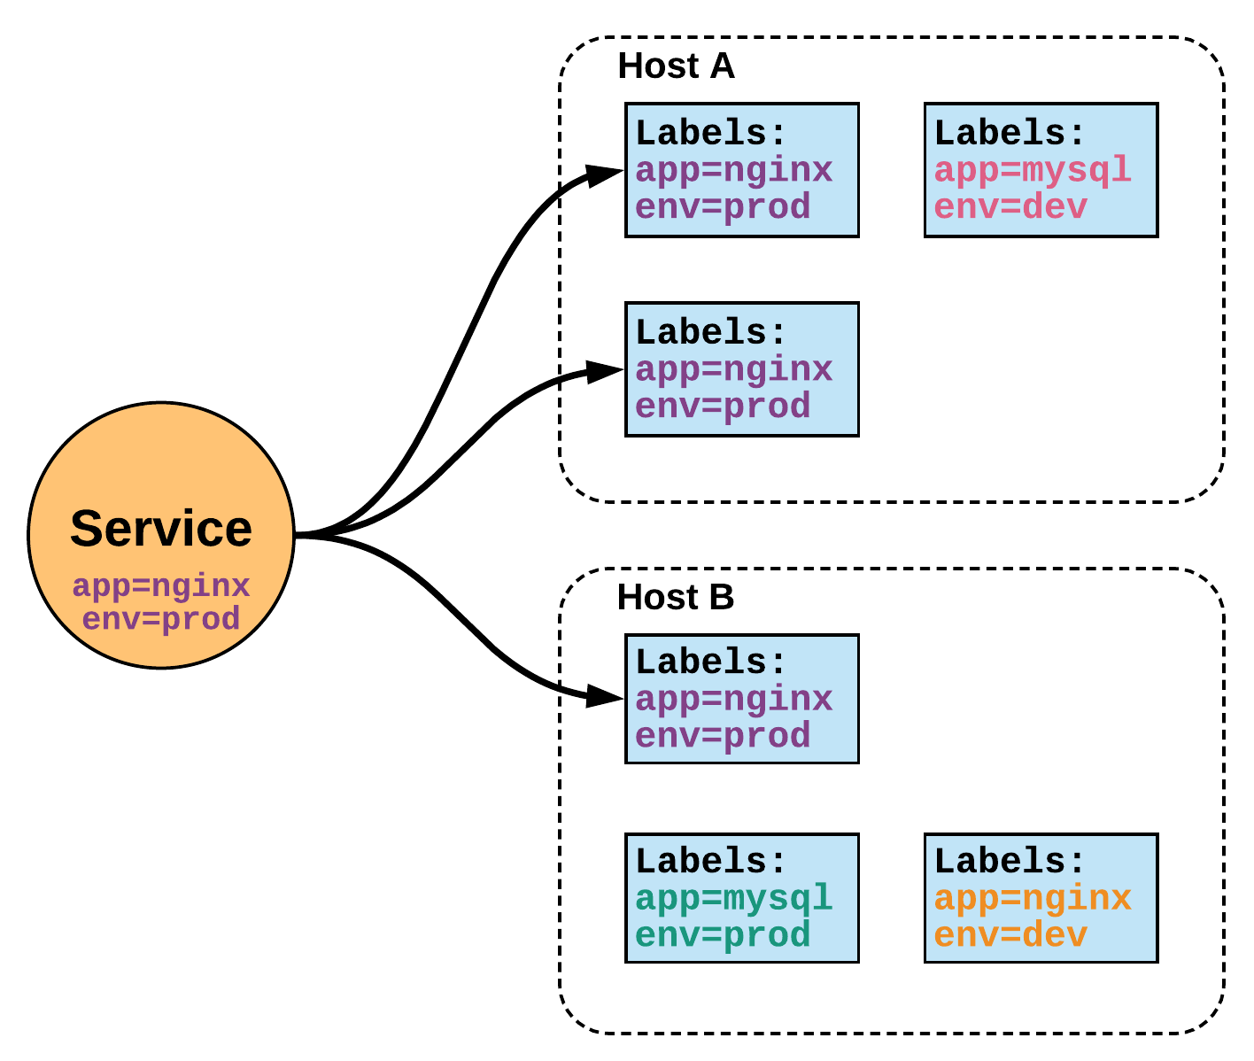
Services
Its Internal Load balancer to your pods. Unified method of accessing the exposed workloads of Pods
Durable resource
static cluster IP
static namespaced DNS name
Notes:
While this may seem like a technical definition, in practice it can be viewed more simply:
A service is an internal load balancer to your pod(s). You have 3 HTTP pods scheduled? Create a service, reference the pods, and (internally) it will load balance across the three.

Slide 15
K8s Architecture
Overview
Notes:
Get right into the meat of the internals.

Slide 16
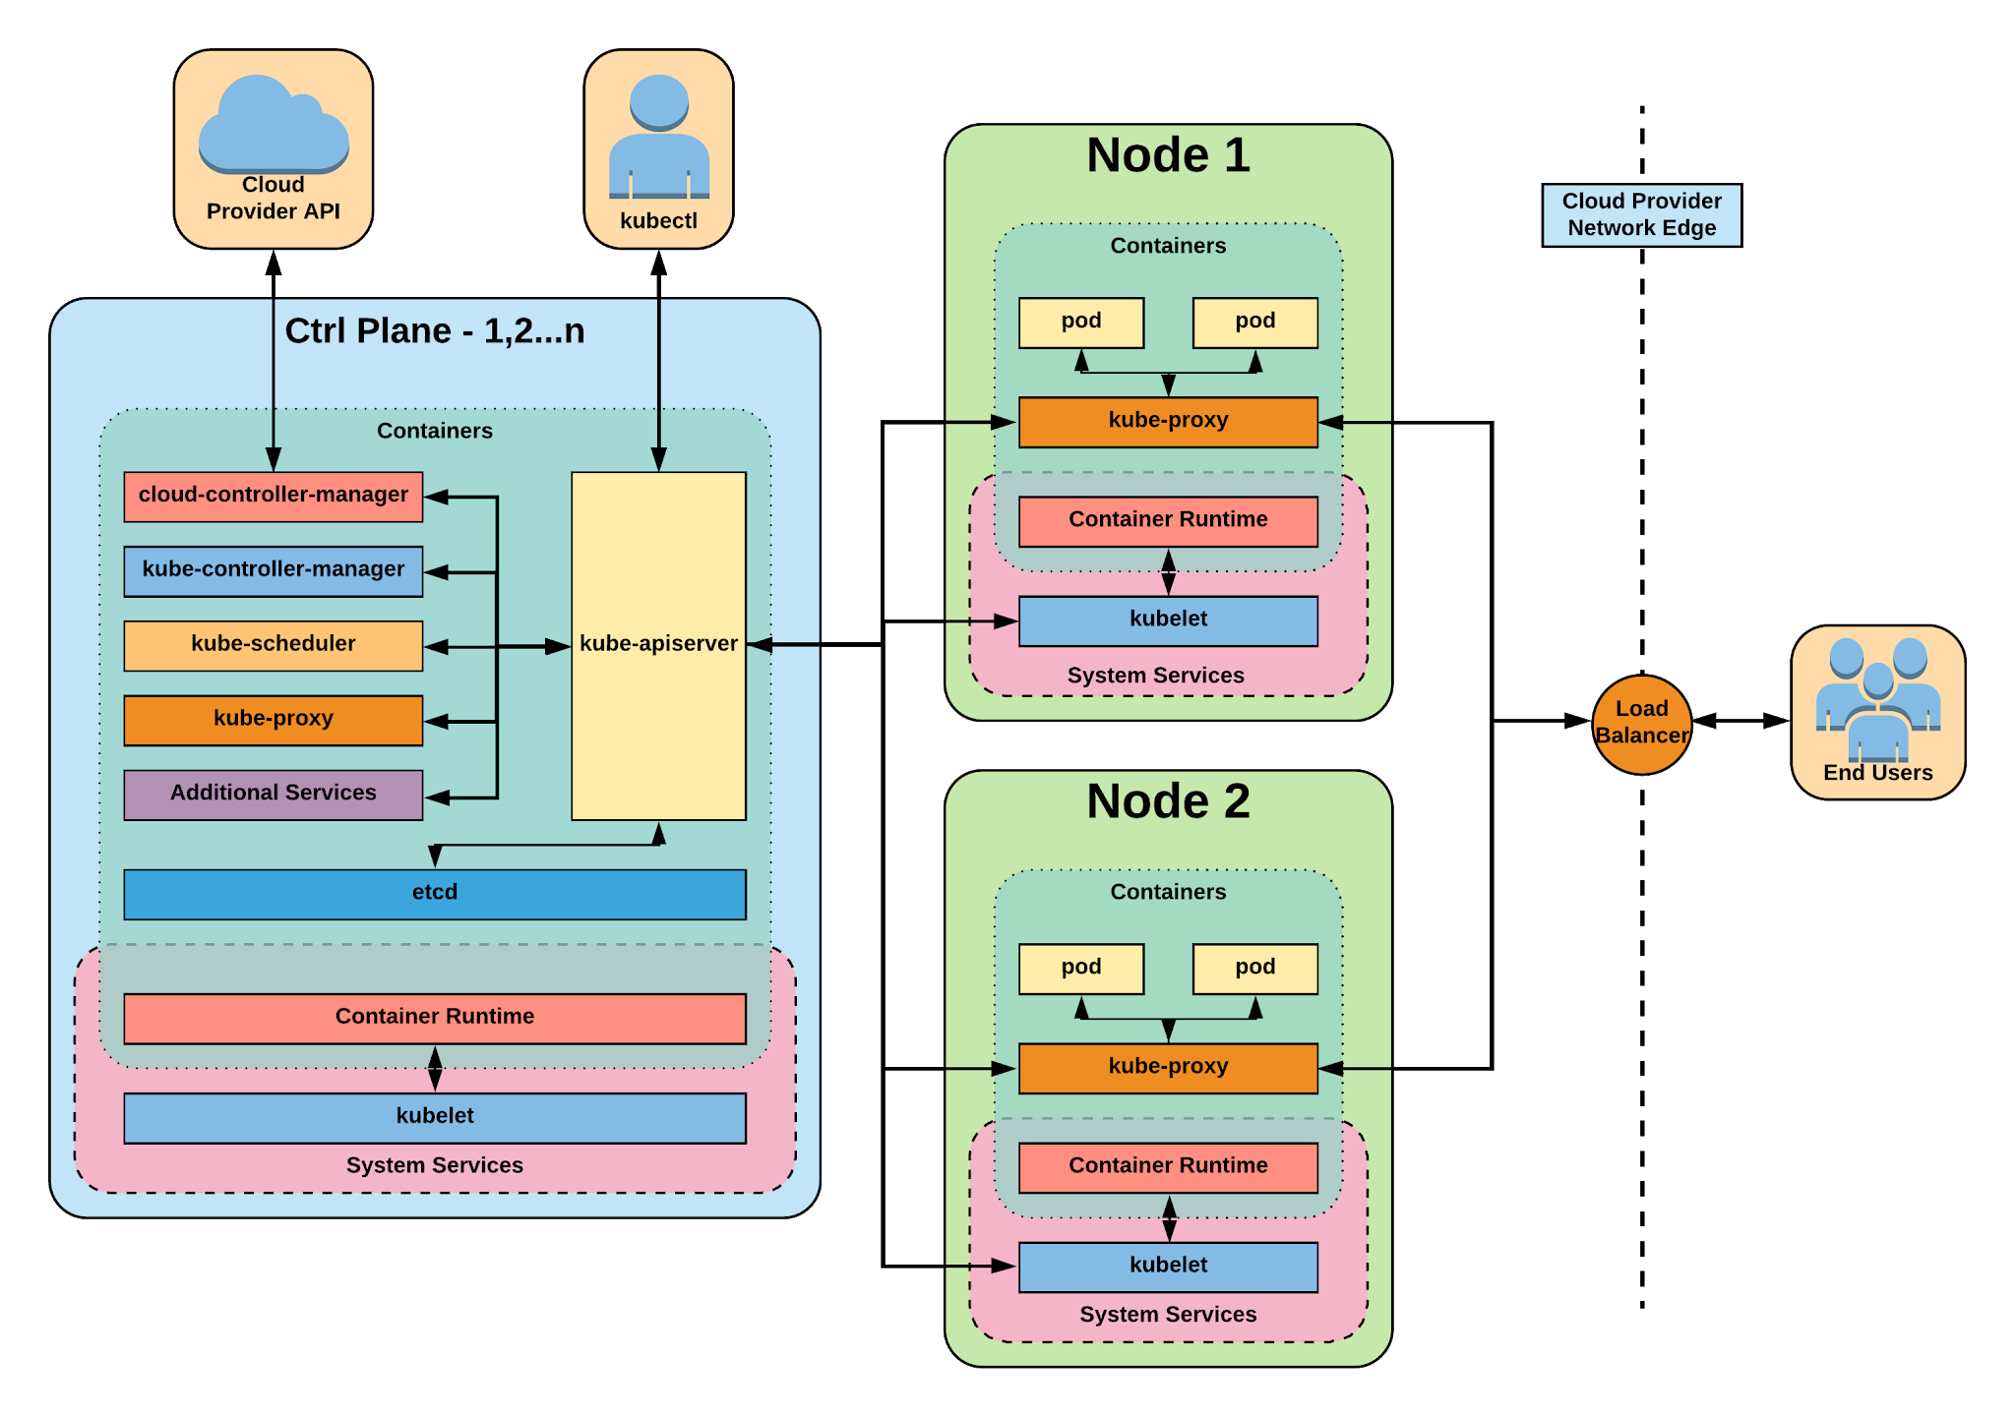
Notes:
The complete picture
Three main processor
Kubelet
Creating the pods responsible and by kubelet,
Responsible for running & maintaining your pod , pass information upon pod is not working,
Agent running on every node, including the control plane
Responsible for running & maintaining your pod , pass information upon pod is not working,
Container Runtime Engine
The containerize itself - typically docker - ContainerD
Kube-proxy
Responsible for Managing the network for Kubernetes cluster , IP addresses
Communication between the multiple pods of an application
Enables in-cluster load-balancing and service discovery
Kube-apiserver
Gate keeper for everything in kubernetes
EVERYTHING interacts with kubernetes through the apiserver
Etcd - backup of your cluster
Distributed storage back end for kubernetes
The apiserver is the only thing that talks to it
Kube-controller-manager-
The home of the core controllers
Example - Replica set , extend from 1 to 2 pods
kube-scheduler
handes placement

Slide 17
Node
Components
Architecture Overview

Slide 18
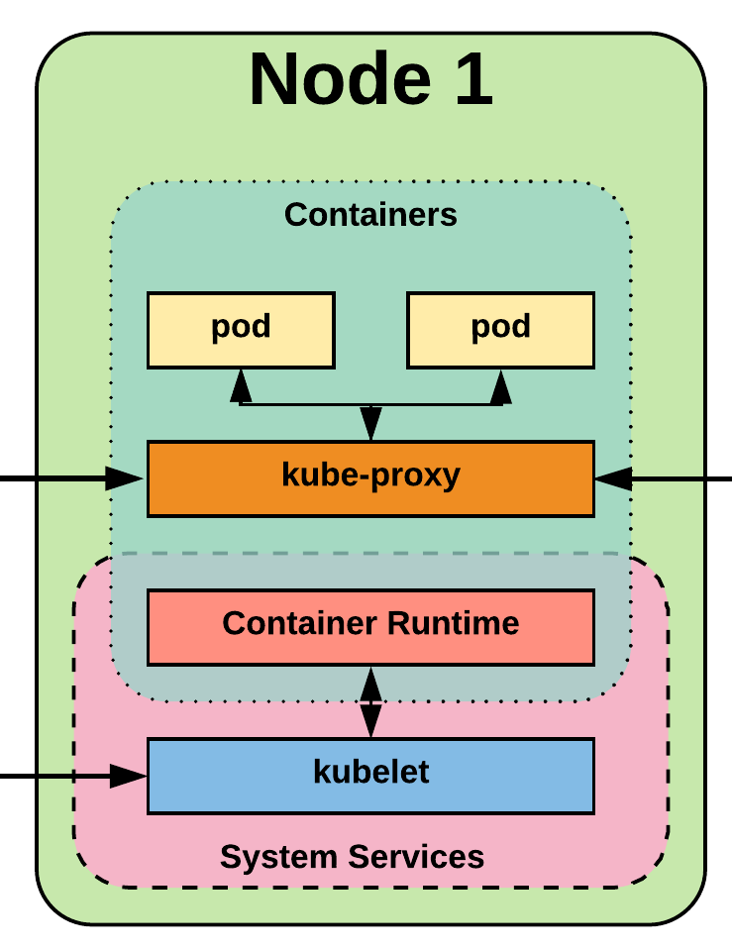
Node Components
kubelet
kube-proxy
Container Runtime Engine
Notes:
Three main processor
Kubelet
Creating the pods responsible and by kubelet,
Responsible for running & maintaining your pod , pass information upon pod is not working,
Agent running on every node, including the control plane
Responsible for running & maintaining your pod , pass information upon pod is not working,
Container Runtime Engine
The containerize itself - typically docker - ContainerD
Kube-proxy
Responsible for Managing the network for Kubernetes cluster , IP addresses
Communication between the multiple pods of an application
Enables in-cluster load-balancing and service discovery

Slide 19
kubelet
An agent that runs on each node in the cluster. It makes sure that containers are running in a pod.
The kubelet takes a set of PodSpecs that are provided through various mechanisms and ensures that the containers described in those PodSpecs are running and healthy.
Notes:
the single host daemon required for a being a part of a kubernetes cluster
can read pod manifests from several different locations
workers: poll kube-apiserver looking for what they should run
masters: run the master services as static manifests found locally on the host

Slide 20
kube-proxy
Manages the network rules on each node.
Performs connection forwarding or load balancing for Kubernetes cluster services.
Notes:
kube-proxy is the plumber
creates the rules on the host to map and expose services
uses a combination of ipvs and iptables to manage networking/loadbalancing
ipvs is more performant and opens the door to a wider feature set (port ranges, better lb rules etc)

Slide 21
Container Runtime Engine
A container runtime is a CRI (Container Runtime Interface) compatible application that executes and manages containers.
Containerd (docker)
Cri-o
Rkt
Kata (formerly clear and hyper)
Virtlet (VM CRI compatible runtime)
Notes:
Kubernetes functions with multiple different containerizers
Interacts with them through the CRI - container runtime interface
CRI creates a ‘shim’ to talk between kubelet and the container runtime
cri-o is a cool one that allows you to run any oci compatible image/runtime in Kubernetes
kata is a super lightweight KVM wrapper

Slide 22
Control Plane Components
Architecture Overview

Slide 23

Control Plane Components
kube-apiserver
etcd
kube-controller-manager
kube-scheduler
cloud-controller-manager
Notes:
Kube-apiserver
Gate keeper for everything in kubernetes
EVERYTHING interacts with kubernetes through the apiserver
Etcd - backup of your cluster
Distributed storage back end for kubernetes
The apiserver is the only thing that talks to it
Kube-controller-manager-
The home of the core controllers
Example - Replica set , extend from 1 to 2 pods
kube-scheduler
handes placement

Slide 24
kube-apiserver
Provides a forward facing REST interface into the kubernetes control plane and datastore.
All clients and other applications interact with kubernetes strictly through the API Server.
Acts as the gatekeeper to the cluster by handling authentication and authorization, request validation, mutation, and admission control in addition to being the front-end to the backing datastore.
Notes:
provides forward facing REST interface into k8s itself
everything, ALL components interact with each other through the api-server
handles authn, authz, request validation, mutation and admission control and serves as a generic front end to the backing datastore

Slide 25
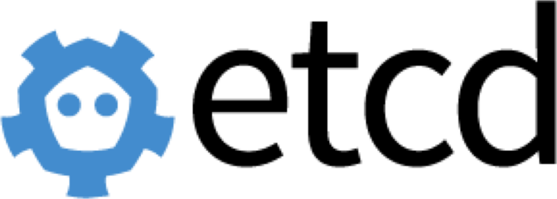
etcd
etcd acts as the cluster datastore.
Purpose in relation to Kubernetes is to provide a strong, consistent and highly available key-value store for persisting cluster state.
Stores objects and config information.
Notes:
is the backing datastore and brain of kubernetes
extremely durable and highly available key-value store
was developed originally by coreos now redhat
however it is in the process of being donated to the CNCF

Slide 26
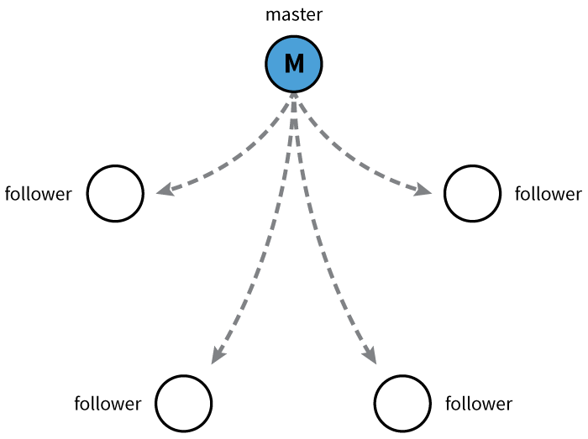
etcd
Uses “Raft Consensus” among a quorum of systems to create a fault-tolerant consistent “view” of the cluster.
https://raft.github.io/
Image Source
Notes:
provides HA via raft
requires quorum of systems
Typically aim for 1,3,5,7 control plane servers

Slide 27
kube-controller-manager
Monitors the cluster state via the apiserver and steers the cluster towards the desired state.
Node Controller: Responsible for noticing and responding when nodes go down.
Replication Controller: Responsible for maintaining the correct number of pods for every replication controller object in the system.
Endpoints Controller: Populates the Endpoints object (that is, joins Services & Pods).
Service Account & Token Controllers: Create default accounts and API access tokens for new namespaces.
Notes:
Its the director behind the scenes
The thing that says “hey I need a few more pods spun up”
Does NOT handle scheduling, just decides what the desired state of the cluster should look like
e.g. receives request for a deployment, produces replicaset, then produces pods

Slide 28
kube-scheduler
Component on the master that watches newly created pods that have no node assigned, and selects a node for them to run on.
Factors taken into account for scheduling decisions include individual and collective resource requirements, hardware/software/policy constraints, affinity and anti-affinity specifications, data locality, inter-workload interference and deadlines.
Notes:
scheduler decides which nodes should run which pods
updates pod with a node assignment, nodes poll checking which pods have their matching assignment
takes into account variety of reqs, affinity, anti-affinity, hw resources etc
possible to actually run more than one scheduler
example: kube-batch is a gang scheduler based off LSF/Symphony from IBM

Slide 29
Notes:
The complete picture

Slide 30
cloud-controller-manager
Node Controller: For checking the cloud provider to determine if a node has been deleted in the cloud after it stops responding
Route Controller: For setting up routes in the underlying cloud infrastructure
Service Controller: For creating, updating and deleting cloud provider load balancers
Volume Controller: For creating, attaching, and mounting volumes, and interacting with the cloud provider to orchestrate volumes
Notes:
Its the director behind the scenes
It Doesn’t required in On Premises
The thing that says “hey I need a few more pods spun up”
Does NOT handle scheduling, just decides what the desired state of the cluster should look like
e.g. receives request for a deployment, produces replicaset, then produces pods

Slide 31
LAB
Create EKS Cluster -AWS
Notes:
Networking is where people tend to get confused, they think of it like Docker
The backing cluster network is a plugin, does not work just out of the box

Slide 32
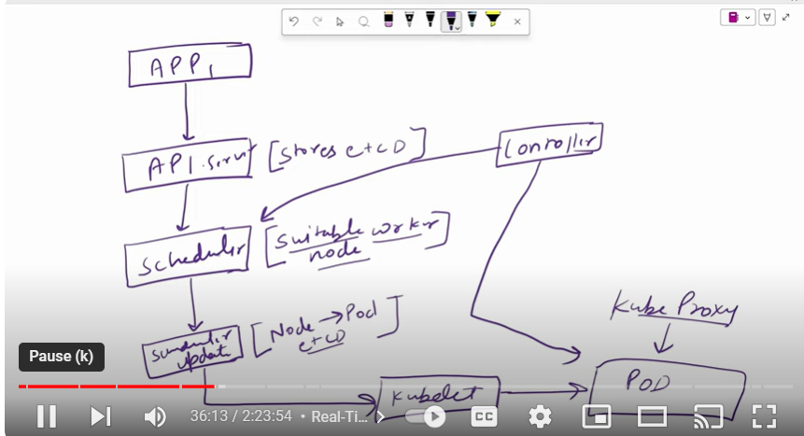
Notes:
The complete picture

Slide 33
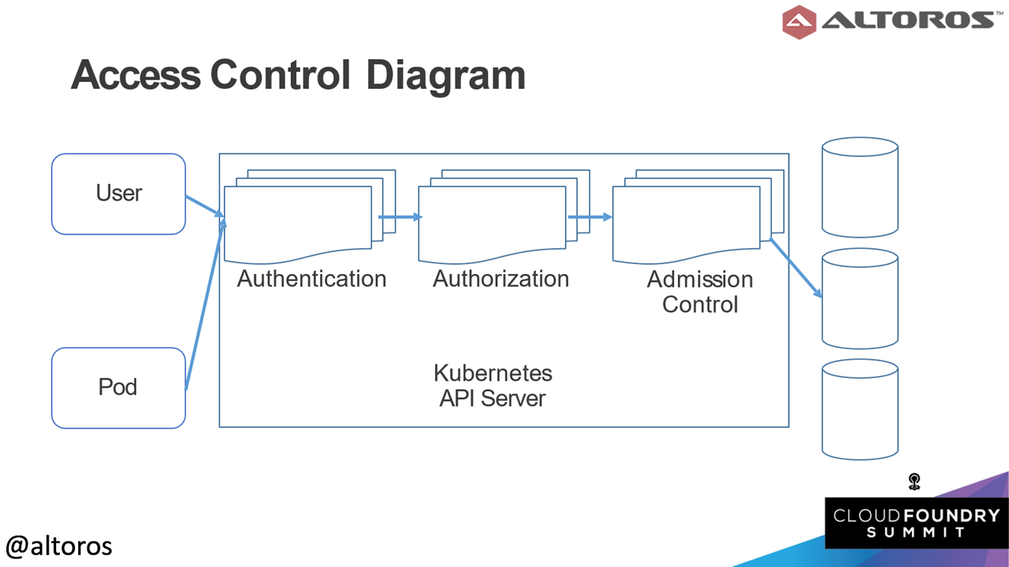
Notes:
The complete picture

Slide 34
Pre-Requisites
Prerequisites
1. AWS Account: Make sure you have an AWS account and configure one ec2 instance
2. kubectl: Install kubectl.
3. AWS CLI: Install and configure the AWS CLI.
4. eksctl: Install eksctl.
Notes:
Reminder to myself: Don’t expand on things on THIS SLIDE, use the next ones
Kubernetes adheres to these fundamental rules for networking

Slide 35
Labs
Download the kubectl binary for your cluster's Kubernetes version from Amazon S3.
Kubernetes 1.30
curl -O https://s3.us-west-2.amazonaws.com/amazon-eks/1.30.0/2024-05-12/bin/linux/amd64/kubectl
Notes:
Reminder to myself: Don’t expand on things on THIS SLIDE, use the next ones
Kubernetes adheres to these fundamental rules for networking

Slide 36
Pods
Pod is smallest “building block” of Kubernetes.
Our application will be deployed in k8s cluster as a POD only
Pods are one or MORE containers that share volumes and namespace.
One application can create Multiple POD replicas for high availability
Every POD one ip gets generated .
POD gets Damanged/crashed then K8s replace it {self healing}

Slide 37
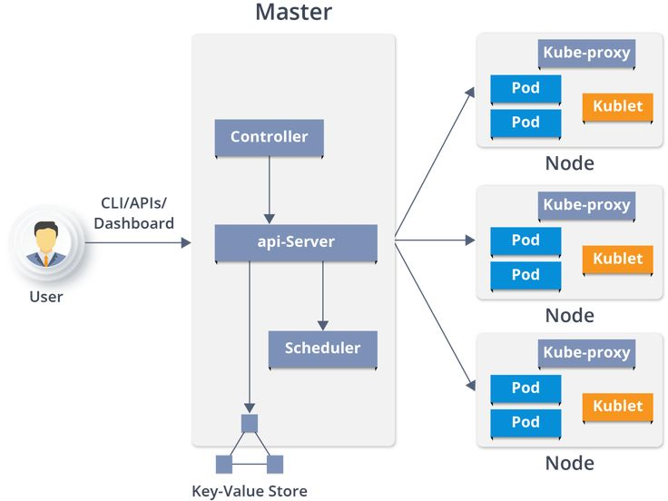

Slide 38
Pre-Requisites
How to create PODS
PODs are not exposed outside world . No access to pod Directly
Notes:
Reminder to myself: Don’t expand on things on THIS SLIDE, use the next ones
Kubernetes adheres to these fundamental rules for networking

Slide 39
Services
There are 3 major service types:
ClusterI P (default) – access PODS with in the clusters- only cluster access
Node Port – access the pod belongs to worker nodes
Load Balancer – access the pod belongs to all worker nodes
Notes:
There are 3 major service types:
ClusterIP (default) – access PODS with in the clusters- only cluster access
NodePort – access the pod belongs to worker nodes
LoadBalancer – access the pod belongs to all worker nodes

Slide 40
SUMMARY
Notes:
Networking is where people tend to get confused, they think of it like Docker
The backing cluster network is a plugin, does not work just out of the box

Slide 41
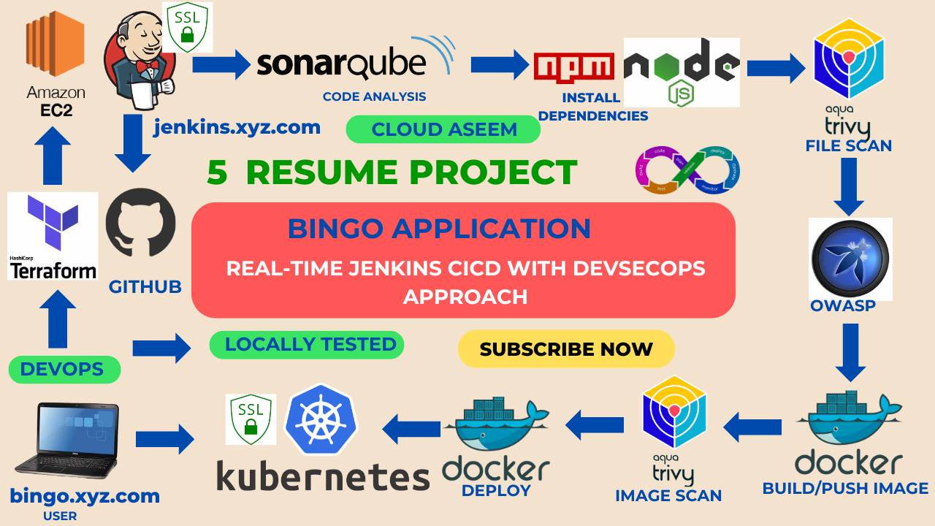
Pipelines
Notes:
There are 3 major service types:
ClusterIP (default) – access PODS with in the clusters- only cluster access
NodePort – access the pod belongs to worker nodes
LoadBalancer – access the pod belongs to all worker nodes

Slide 42
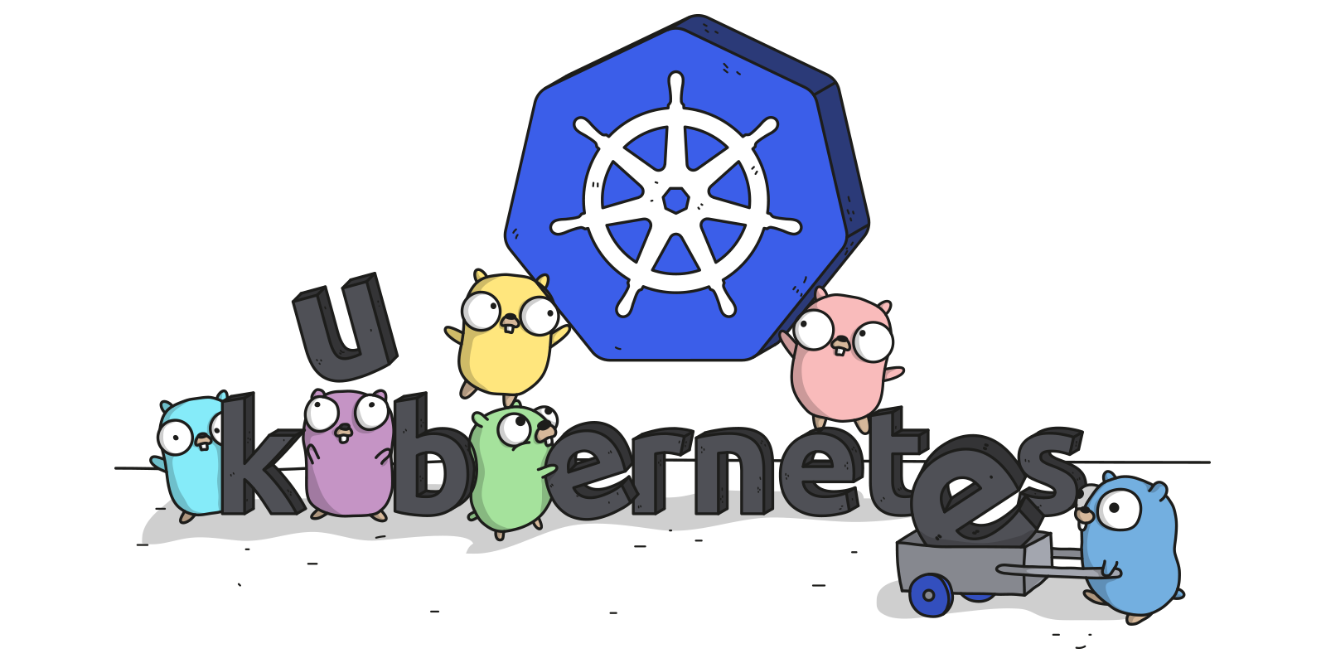
Links
Free Kubernetes Courses https://www.edx.org/
Interactive Kubernetes Tutorials https://www.katacoda.com/courses/kubernetes
Learn Kubernetes the Hard Way https://github.com/kelseyhightower/kubernetes-the-hard-way
Official Kubernetes Youtube Channel https://www.youtube.com/c/KubernetesCommunity
Official CNCF Youtube Channel https://www.youtube.com/c/cloudnativefdn
Track to becoming a CKA/CKAD (Certified Kubernetes Administrator/Application Developer) https://www.cncf.io/certification/expert/
Awesome Kubernetes https://www.gitbook.com/book/ramitsurana/awesome-kubernetes/details
Notes:
There are 3 major service types:
ClusterIP (default) – access PODS with in the clusters- only cluster access
NodePort – access the pod belongs to worker nodes
LoadBalancer – access the pod belongs to all worker nodes

Slide 43
Links
Free Kubernetes Courses https://www.edx.org/
Interactive Kubernetes Tutorials https://www.katacoda.com/courses/kubernetes
Learn Kubernetes the Hard Way https://github.com/kelseyhightower/kubernetes-the-hard-way
Official Kubernetes Youtube Channel https://www.youtube.com/c/KubernetesCommunity
Official CNCF Youtube Channel https://www.youtube.com/c/cloudnativefdn
Track to becoming a CKA/CKAD (Certified Kubernetes Administrator/Application Developer) https://www.cncf.io/certification/expert/
Awesome Kubernetes https://www.gitbook.com/book/ramitsurana/awesome-kubernetes/details
Notes:
There are 3 major service types:
ClusterIP (default) – access PODS with in the clusters- only cluster access
NodePort – access the pod belongs to worker nodes
LoadBalancer – access the pod belongs to all worker nodes

